Slide 1
Frame Booster
Kamil Barszczak

Slide 2
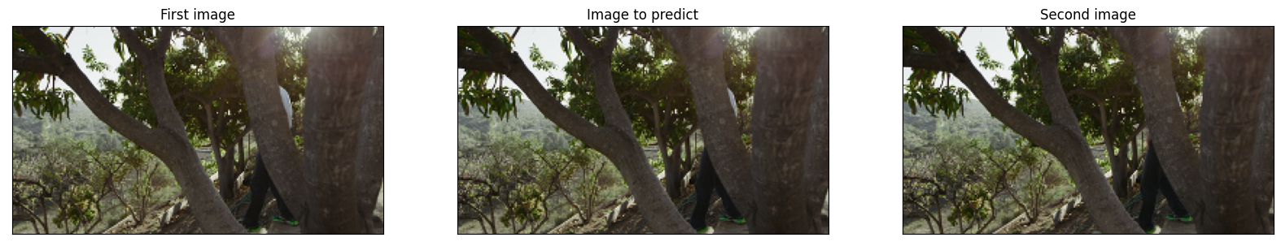
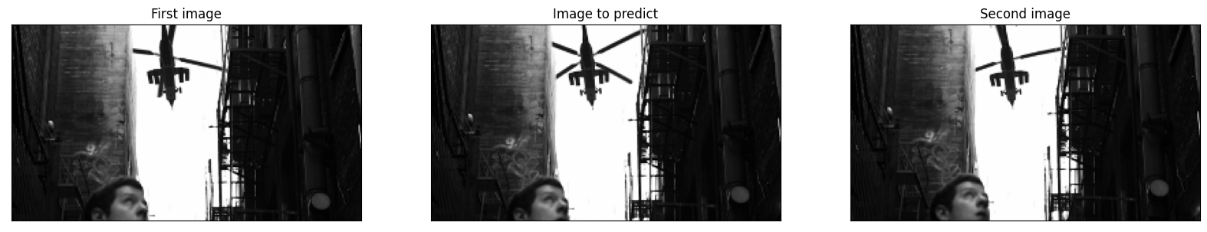
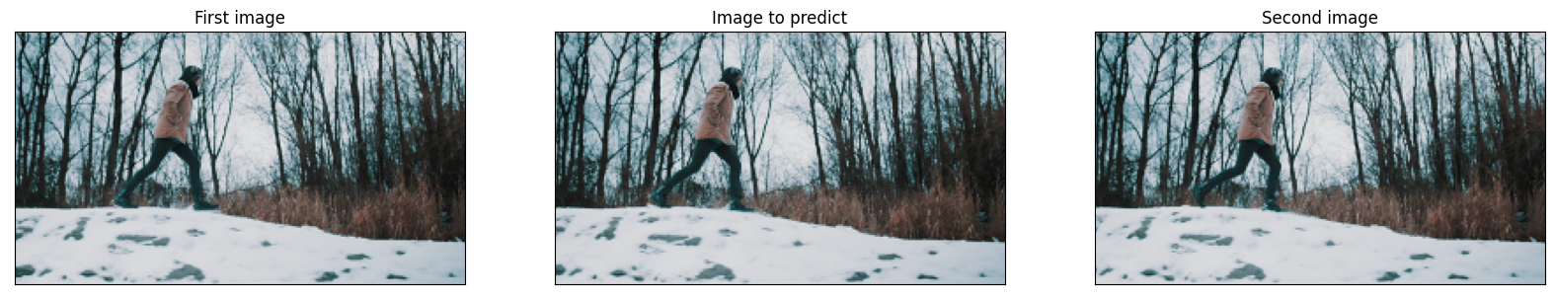
Frame interpolation

Slide 3
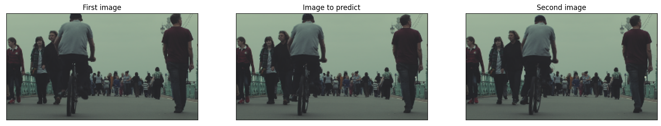
Dataset
Vimeo90K - triplet (256x144px RGB)
50000 testing samples
3000 testing samples
1000 validating samples

Slide 4
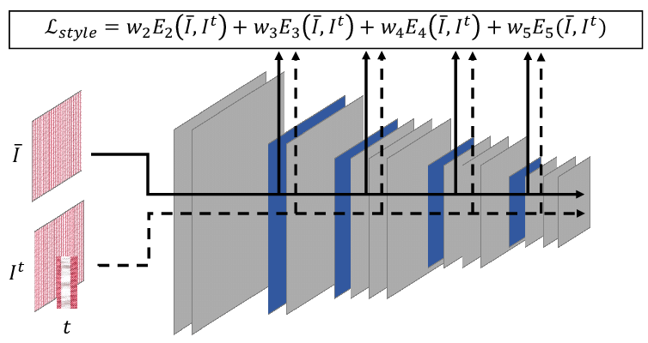
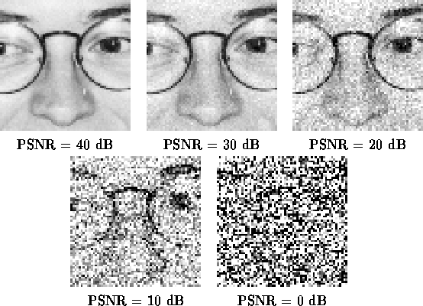
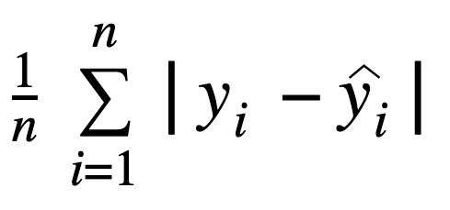
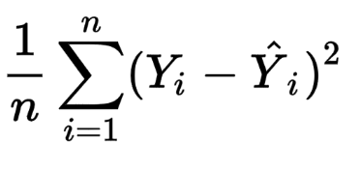
Loss function
Perceptual Loss:
PSNR:
MAE:
MSE:
Loss = 0.5*Perceptual + PSNR + 5.0*MAE + 10.0*MSE

Slide 5
Trening
Tested optimizers
Nadam (lr=0.0001)
Adam (lr=0.0001)
Epochs: ~5
Batch size: 2
Metrics: MAE, MSE, PSNR
Average epoch time: ~2.5h
GPU used: GTX970 4GB

Slide 6
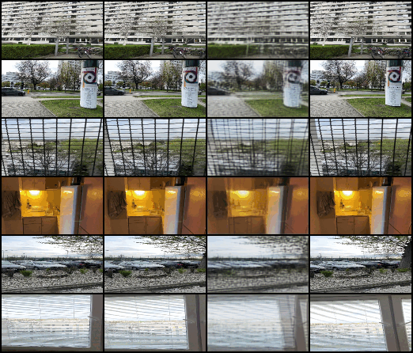
Benchmark
Automatic tool for testing multiple models sequentially
Saves training progress, model state, and other features such as activation masks
Executes training on a smaller training dataset (5000 samples of 128x72px RGB images)
Saves the learning history (measurements for each step)
Creates png files with training and validating histories
Evaluates the training on the testing dataset
Example of training progress captured by the benchmark:

Slide 7
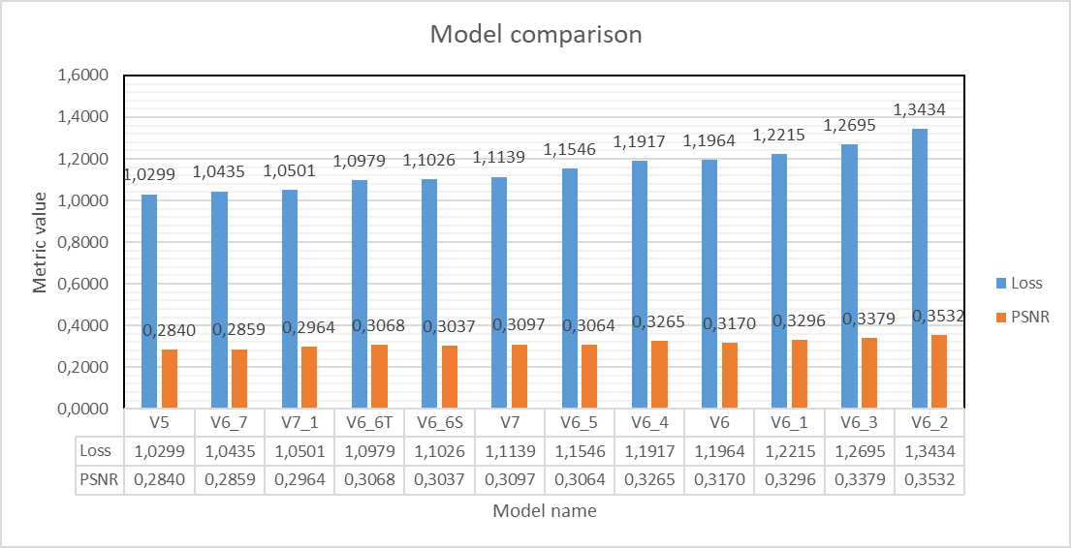
Models results (benchmark)

Slide 8
Best 3 Models
Model V5
U-Net type architecture (with warping layers between the encoder and the decoder)
Warping both images
Feedforward flow prediction CNN
Encoder with skip connections (same as FILM model)
Sigmoid activation
Model V6_7
Attention U-Net type architecture (with warping layers between the encoder and the decoder)
Warping both images
DenseNet flow prediction CNN
Encoder same as model V5
Clipped linear activation (into the range from 0 to 1)
Model V7_1
Encoder-Decoder architecture (with U-Net type flow prediction layer between the encoder and the decoder)
Warping both images
ResNet flow prediction CNN
DenseNet encoder
Partial ResNet decoder
Activation same as model V6_7

Slide 9
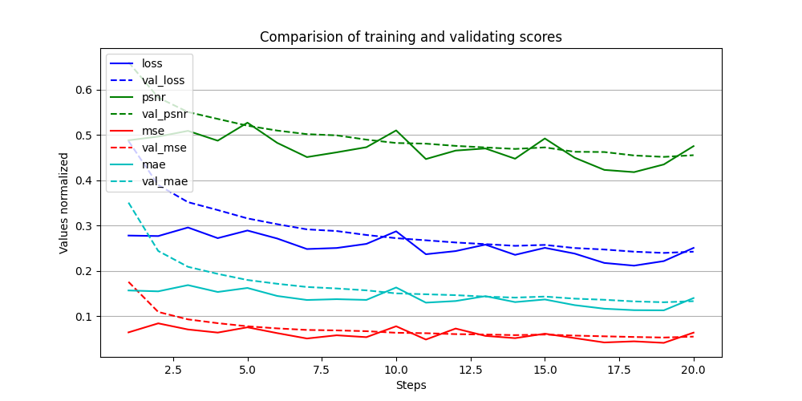
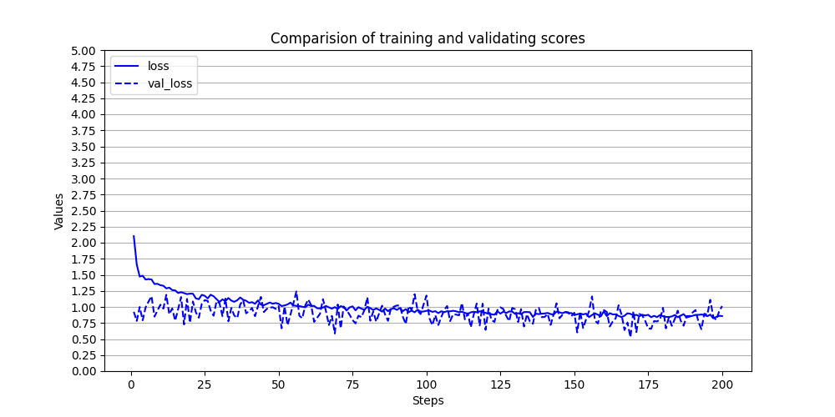
3rd best model (V7_1)
Loss | PSNR | MSE | MAE
0.8502 | 30.11 | 0.0013 | 0.0161

Slide 10
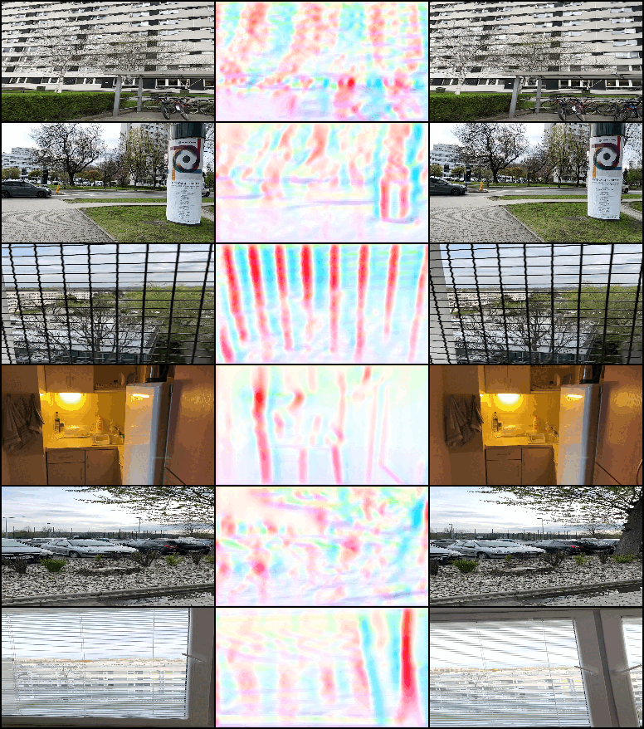
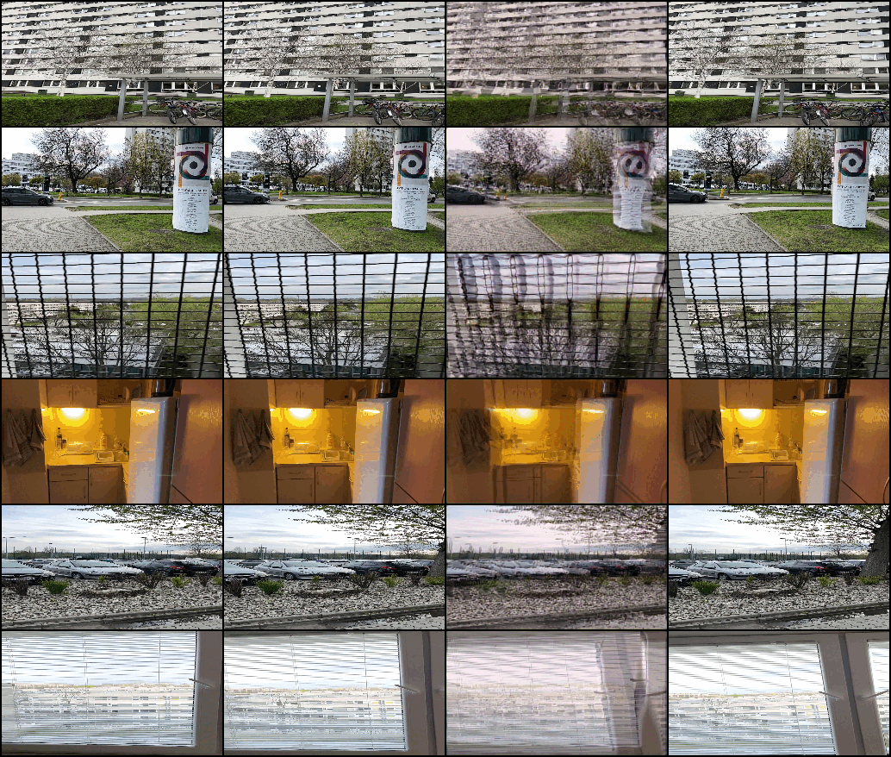
Learning progress of model V7_1

Slide 11
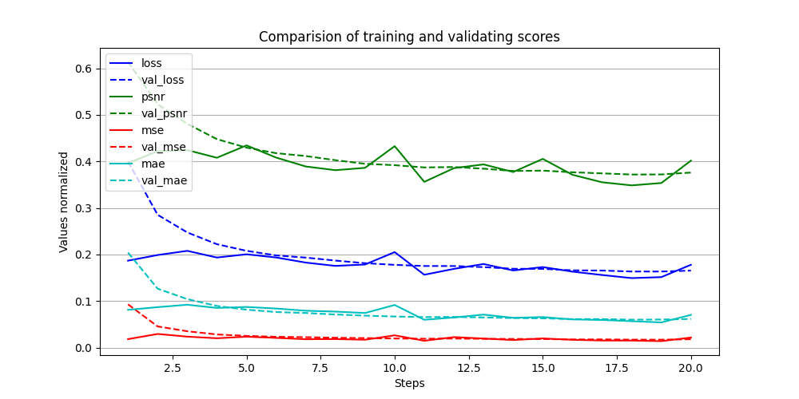
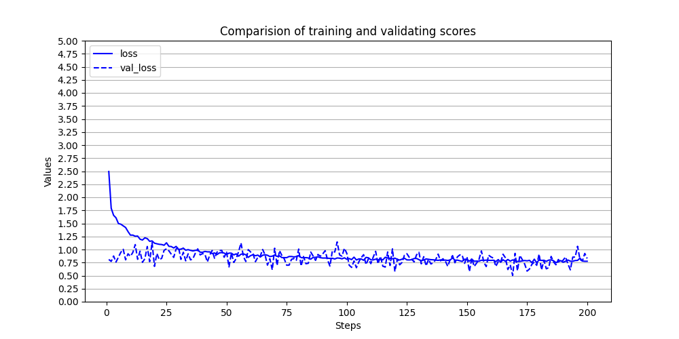
2nd best model (V6_7)
Loss | PSNR | MSE | MAE
0.7803 | 31.00 | 0.0010 | 0.0143

Slide 12
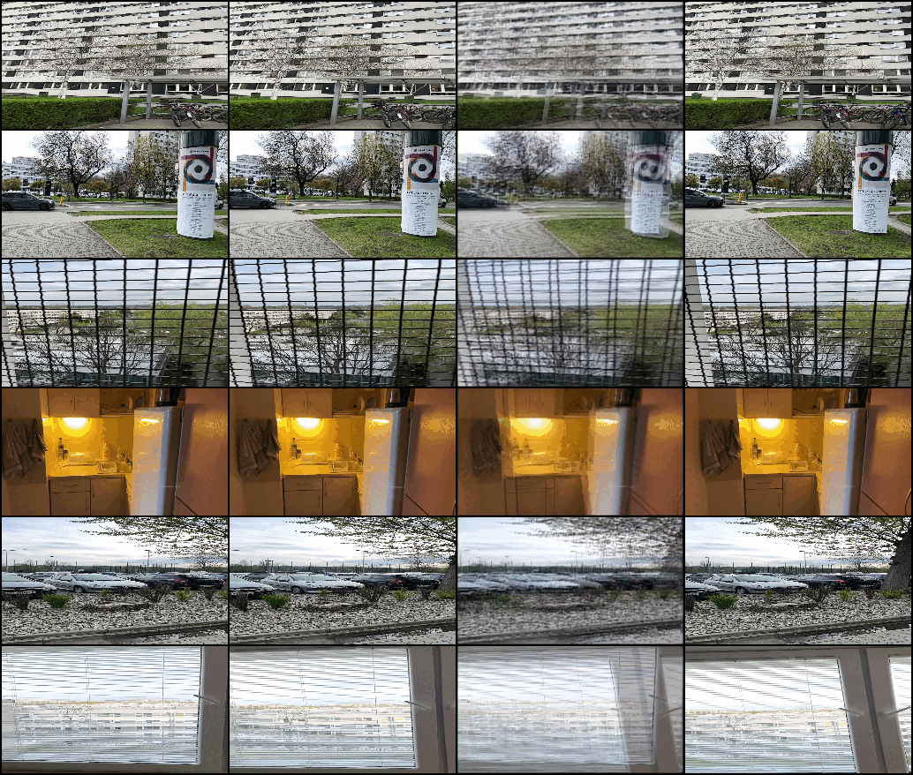
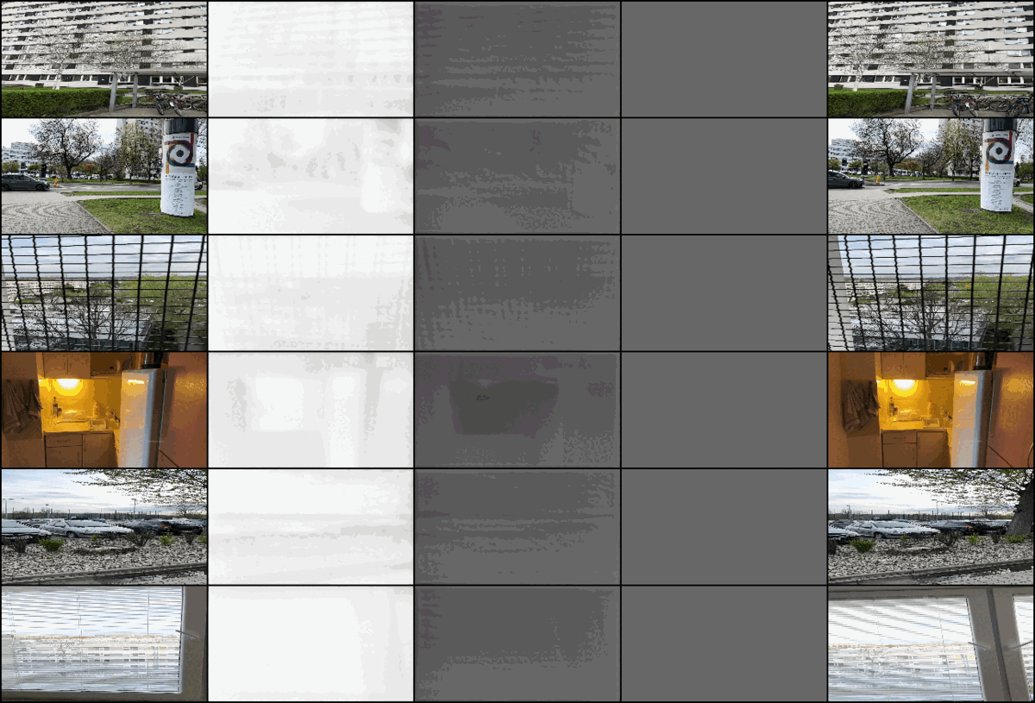
Learning progress of model V6_7

Slide 13
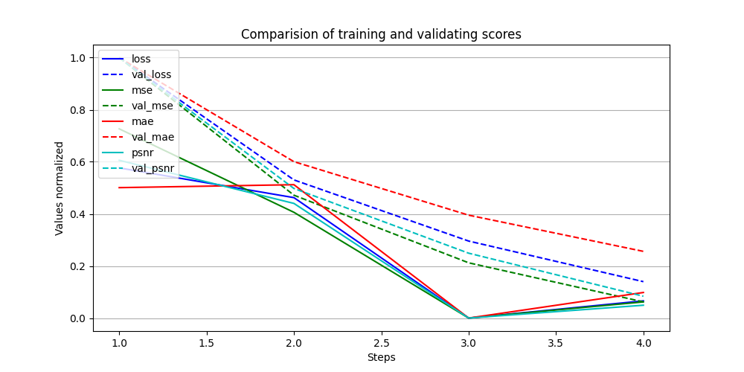
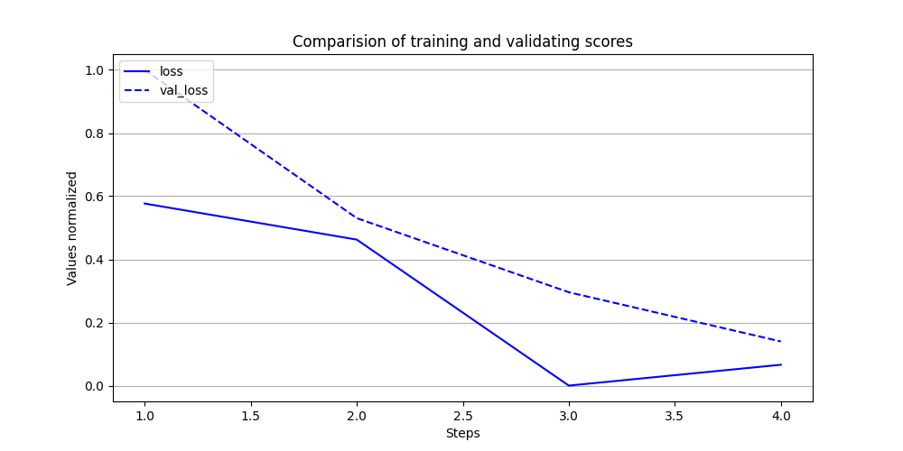
Best model (V5)
Loss | PSNR | MSE | MAE
0.7342 | 32.33 | 0.0007 | 0.0123

Slide 14
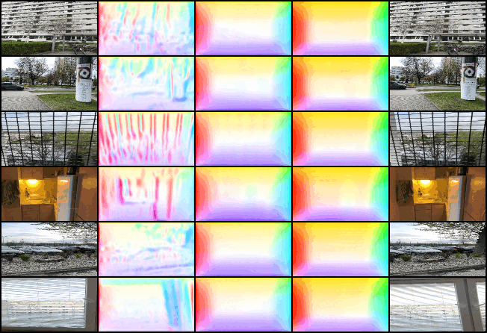
Learning progress of model V5

Slide 15
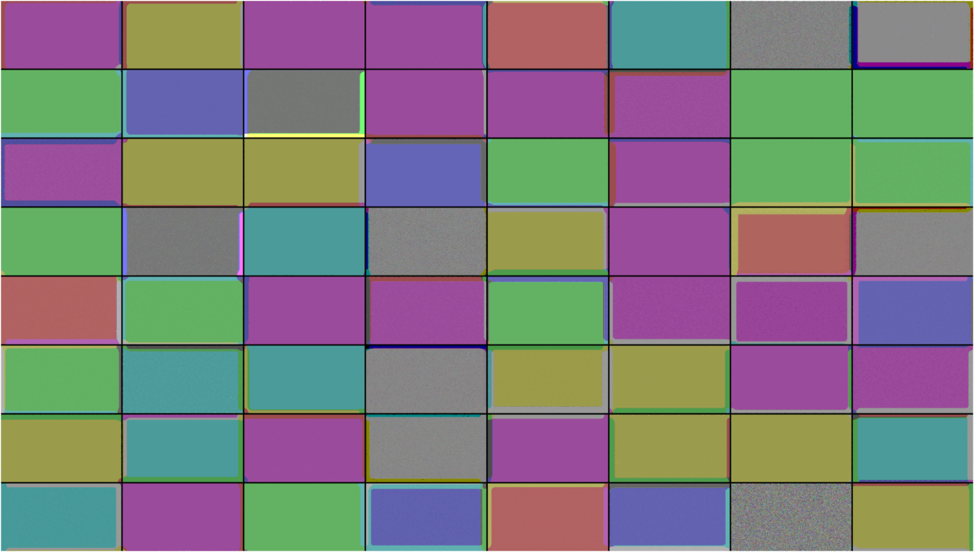
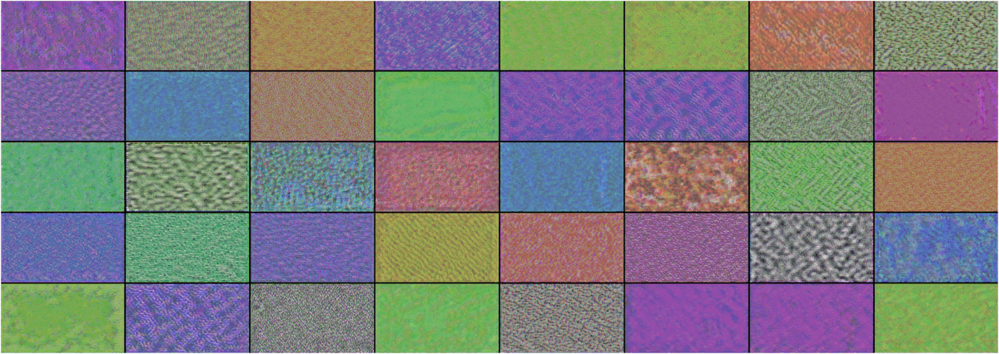
CNN filters of model V5

Slide 16




Results
GT
V5
V6_7
V7_1

Slide 17

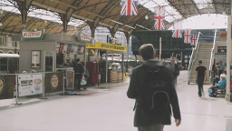
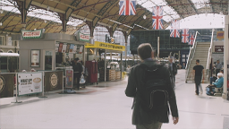

Results
GT
V5
V6_7
V7_1

Slide 18
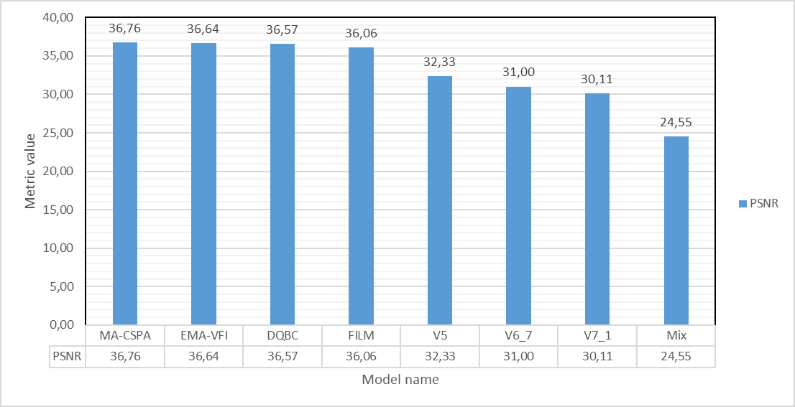
Comparison to SOTA models

Slide 19
Tests
Batch Normalization - dramatically slowed down the training process and decreased the model’s performance
AvgPool2d vs Conv2d (with stride=2) - no significant difference was noticed
Upsample vs ConvTranspose2d (with stride=2) - the upsampling layer performed better resulting in a higher PSNR score
Different net architectures (Feedforward, ResNet, DenseNet, U-Net, Attention U-Net) - results presented in the previous slides
Nadam vs Adam optimizer - the Nadam optimizer reached the goal faster and lead to the better result after the same training steps
Dropout - did not make any difference
LeakyReLU (with a={0.01, 0.1, 0.2, 0.3}) vs PReLU - use of the PReLU activation resulted in a lower loss value
Sigmoid vs Clipped Linear output activation - Clipped linear activation lowered the loss value by around 0.5%

Slide 20
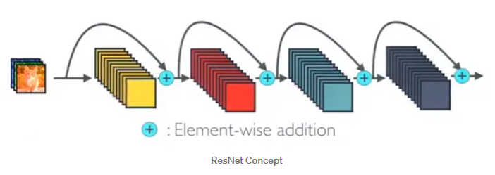
ResNet

Slide 21
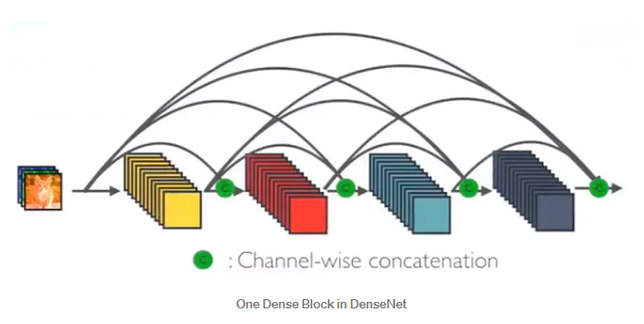
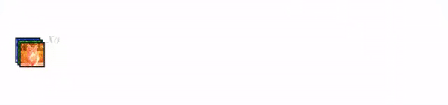
DenseNet

Slide 22
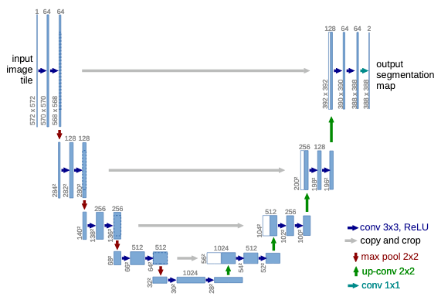
U-Net

Slide 23
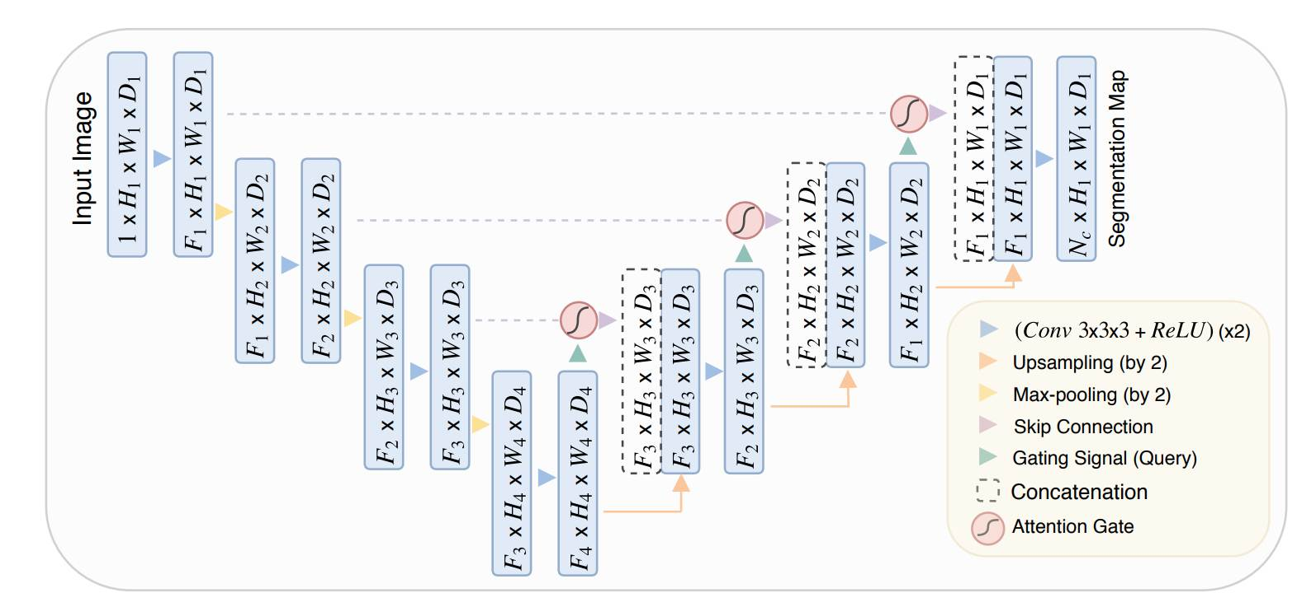
Attention U-Net

Slide 24
Resources
Frame Booster GitHub repository
Single Image Super Resolution with deep convolutional neural networks
Real-Time Intermediate Flow Estimation for Video Frame Interpolation
Depth-Aware Video Frame Interpolation
BiFormer: Learning Bilateral Motion Estimation via Bilateral Transformer for 4K Video Frame Interpolation
Attention is all you need
Video Frame Interpolation via Adaptive Convolution
Large Motion Frame Interpolation
FILM: Frame Interpolation for Large Motion
Multi-view Image Fusion
Perceptual Losses for Real-Time Style Transfer and Super-Resolution
Image Style Transfer Using Convolutional Neural Networks
Exploring Motion Ambiguity and Alignment for High-Quality Video Frame Interpolation
PWC-Net: CNNs for Optical Flow Using Pyramid, Warping, and Cost Volume
Review: DenseNet — Dense Convolutional Network (Image Classification)

